Slide 1


Ferri Lab Presentation
Quang Le
3/9/2021

Slide 2

Table of Contents
Overall Hypothesis for Consumer Perception
Data Featurization
Current Literature on Product Reviews
Future Work
Conclusion

Slide 3
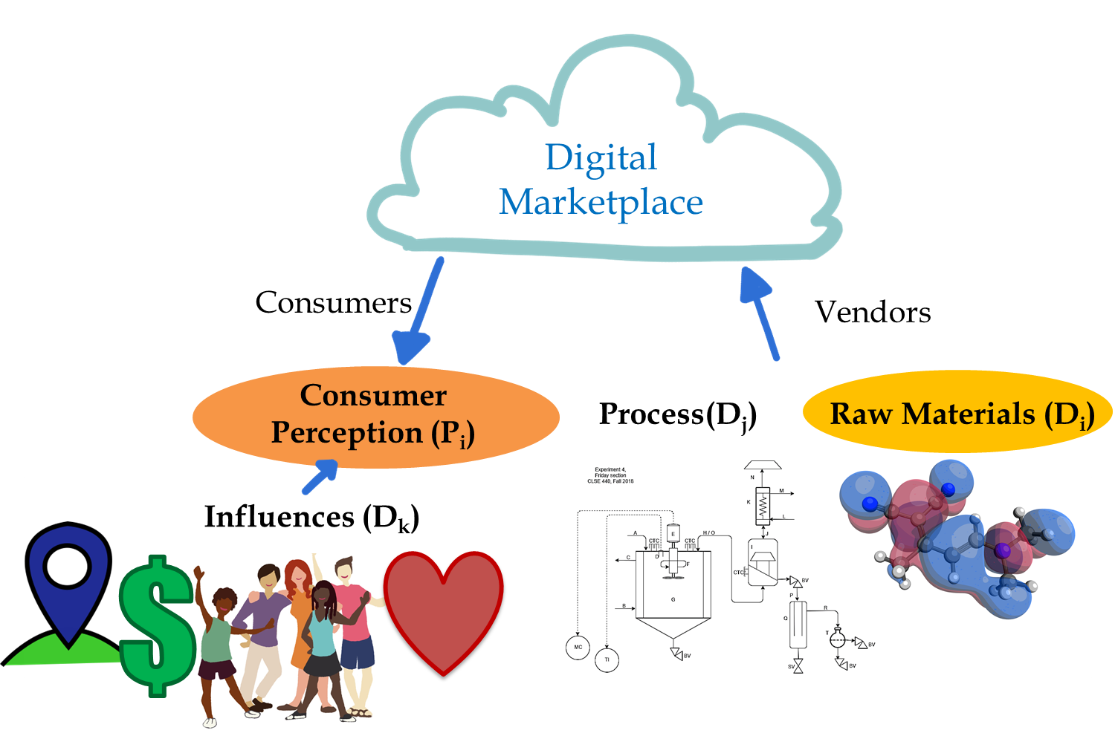
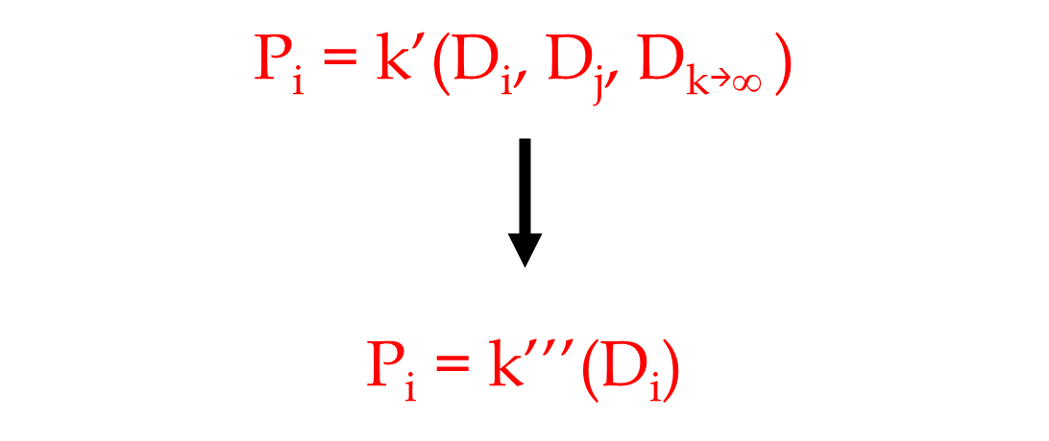
Overall Hypothesis
Notes:
Intro on the concept of consumer perception.
This schema presents our general hypothesis on what affects consumer perception
Explain why we want to reduce the problem down to raw materials (abundance in data, much easier to quantify than process and influences, easier to do data science on)

Slide 4
Table of Contents
Overall Hypothesis for Consumer Perception
Data Featurization
Current Literature on Product Reviews
Future Work
Conclusion

Slide 5
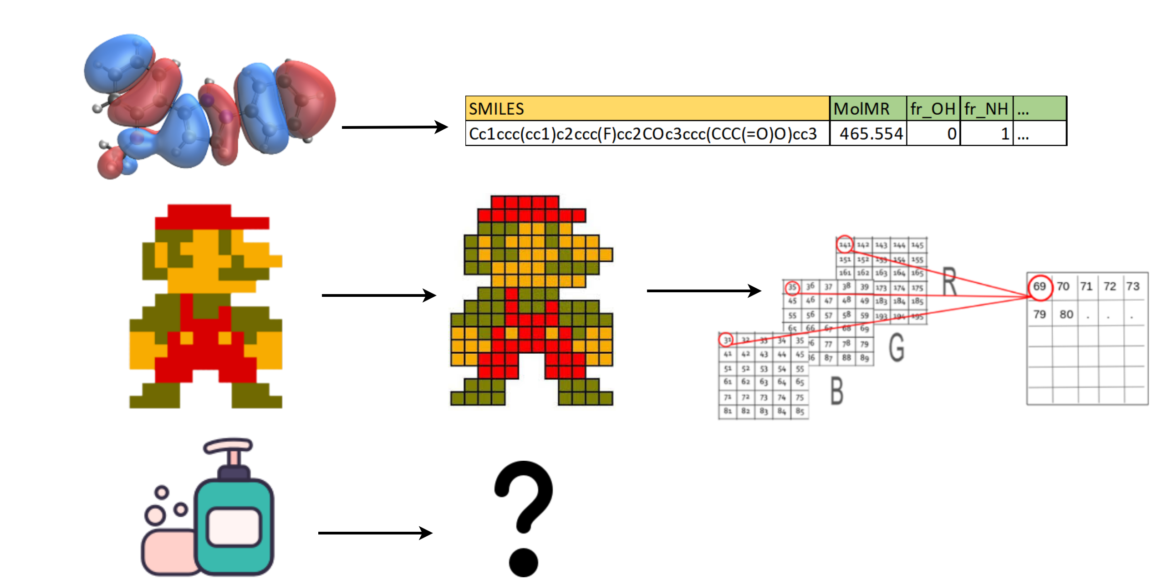
Data Featurization
Notes:
Explain the concept of data featurization and how it relates to machine learning
Examples: Molecules, pictures, … (Explain a bit about how rdkit can featurize molecules)
Talk about the complexity in featurizing consumer products (there are many things that make up a product (labels, reviews, ingredients, advertisement, …)
and each of them require a different set of skills and tools to extract. It is also difficult to create a generalizable way to featurize them

Slide 6
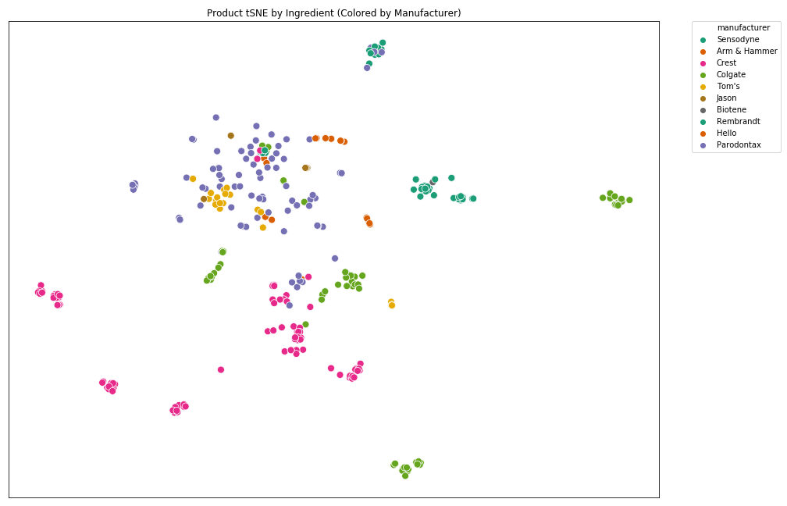
Clustering Toothpaste by ingredients
Notes:
Explain the concept of data featurization and how it relates to machine learning
Examples: Molecules, pictures, … (Explain a bit about how rdkit can featurize molecules)
Talk about the complexity in featurizing consumer products (there are many things that make up a product (labels, reviews, ingredients, advertisement, …)
and each of them require a different set of skills and tools to extract. It is also difficult to create a generalizable way to featurize them

Slide 7
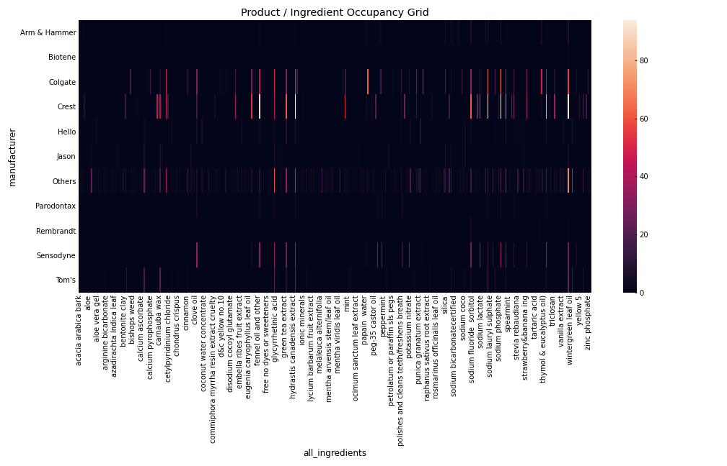
Heat Map Of Product/Ingredient
Notes:
Explain the concept of data featurization and how it relates to machine learning
Examples: Molecules, pictures, … (Explain a bit about how rdkit can featurize molecules)
Talk about the complexity in featurizing consumer products (there are many things that make up a product (labels, reviews, ingredients, advertisement, …)
and each of them require a different set of skills and tools to extract. It is also difficult to create a generalizable way to featurize them

Slide 8
Table of Contents
Overall Hypothesis for Consumer Perception
Data Featurization
Current Literature on Product Reviews
Future Work
Conclusion

Slide 9
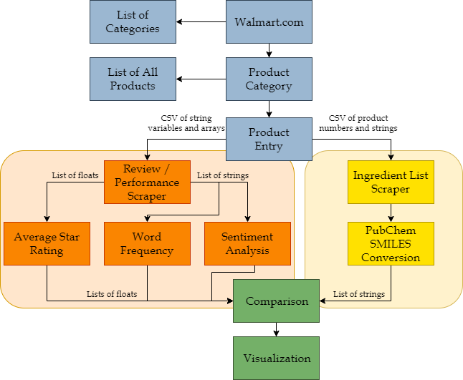
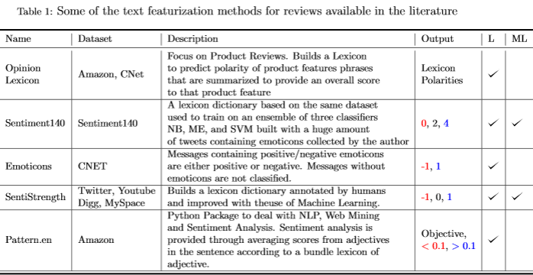
Current Literature on Product Reviews
Example Workflow
Notes:
Explain the example workflow on product reviews
Explain the term “Lexicon” and how it is frequently used in product review studies
Explain other type of work on product reviews

Slide 10
Table of Contents
Overall Hypothesis for Consumer Perception
Data Featurization
Current Literature on Product Reviews
Future Work
Conclusion

Slide 11
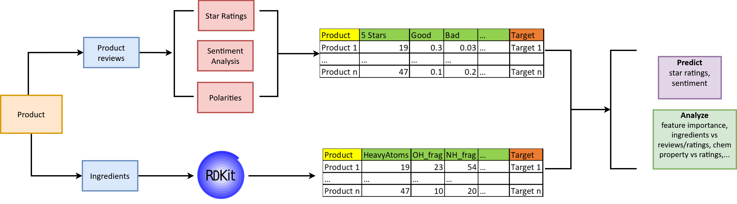
Future work
Notes:
Combining both product reviews (text featurization) and ingredients (molecular featurization) for both machine learning and data analyzation.
This work has never been done before.
Explain how we can combine these types of data together

Slide 12
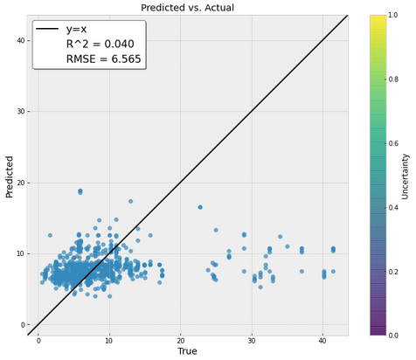
Price Predictions Ingredients + Manufacturer
Notes:
Combining both product reviews (text featurization) and ingredients (molecular featurization) for both machine learning and data analyzation.
This work has never been done before.
Explain how we can combine these types of data together

Slide 13
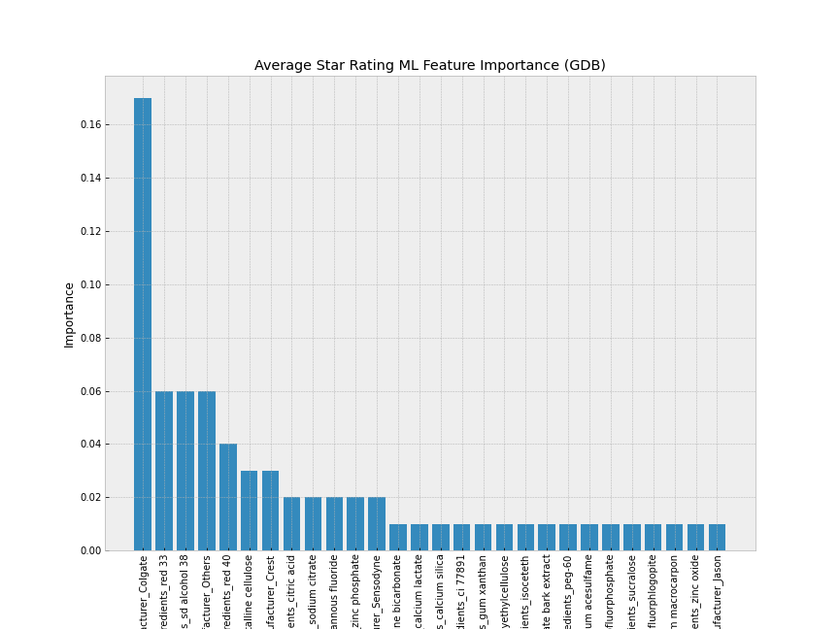
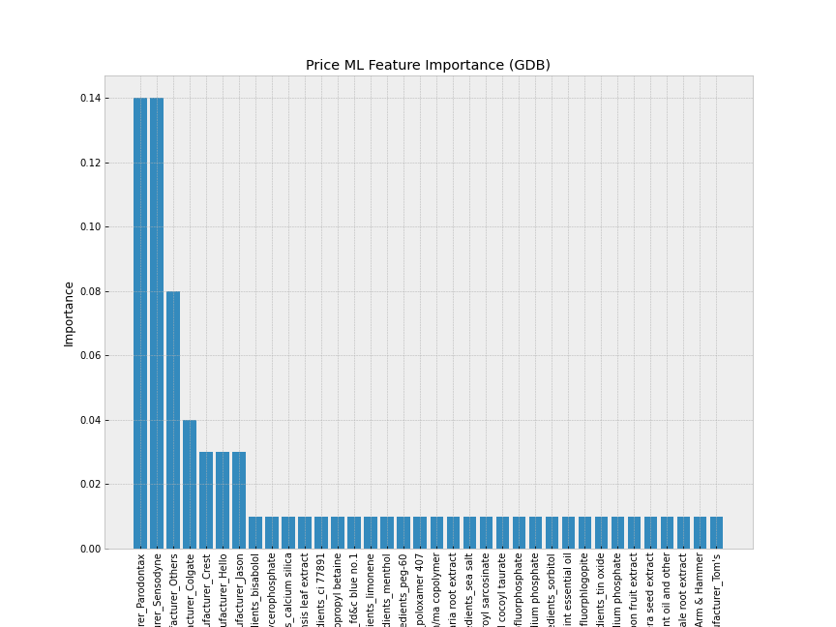
Ingredient Importance
Notes:
Combining both product reviews (text featurization) and ingredients (molecular featurization) for both machine learning and data analyzation.
This work has never been done before.
Explain how we can combine these types of data together

Slide 14
Table of Contents
Overall Hypothesis for Consumer Perception
Data Featurization
Current Literature on Product Reviews
Future Work
Conclusion

Slide 15
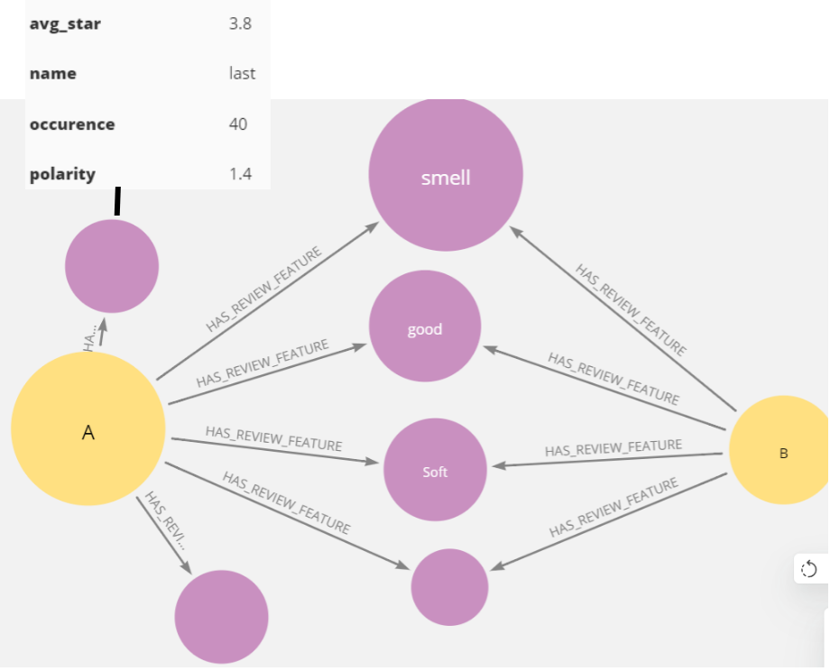
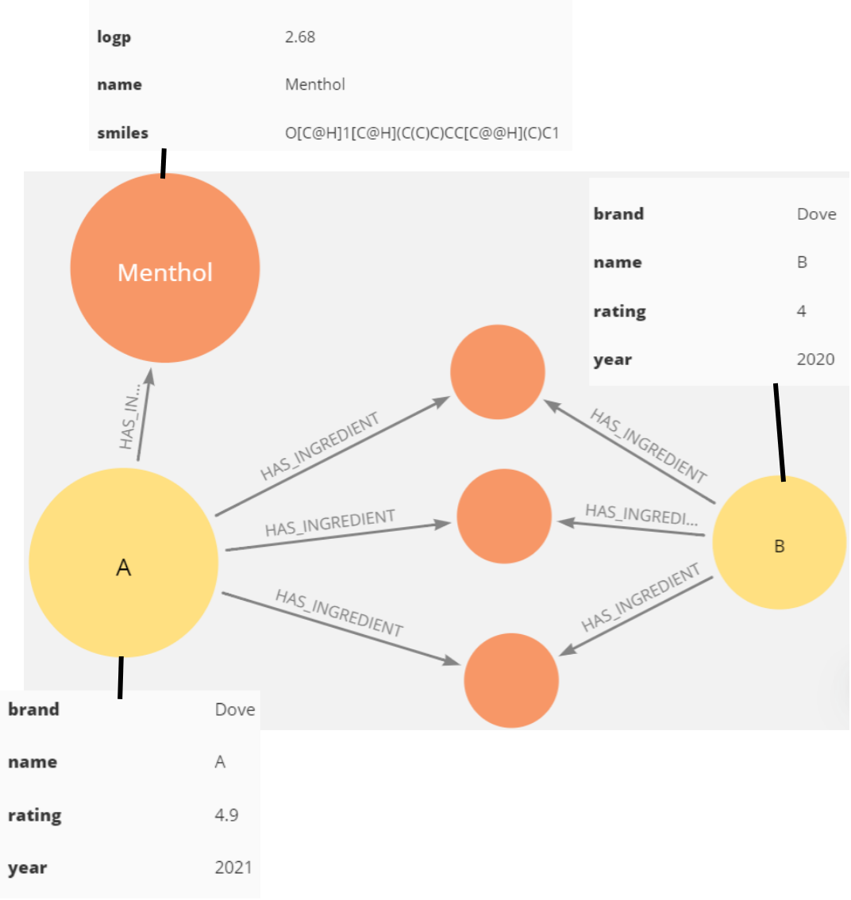
Neo4j
15
Notes:
Neo4j can help us on data analysis and visualizations. We can look at the same products with different perspectives and overlap them to give new insight that tables can’t.

Slide 16
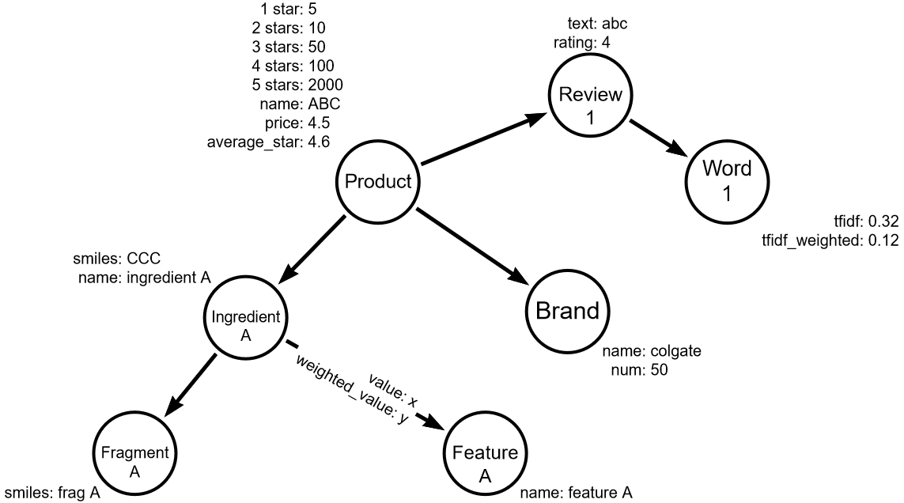
Ontology
Notes:
Explain the concept of data featurization and how it relates to machine learning
Examples: Molecules, pictures, … (Explain a bit about how rdkit can featurize molecules)
Talk about the complexity in featurizing consumer products (there are many things that make up a product (labels, reviews, ingredients, advertisement, …)
and each of them require a different set of skills and tools to extract. It is also difficult to create a generalizable way to featurize them

Slide 17
Conclusion
We want to study the relationship between raw ingredients and consumer perception
There isn’t a generalizable way to featurize product ingredients
Much work has been done on product reviews which give us good pointers and reference
There is potential for us to jump to this space by utilizing and combining bioinformatics with product reviews

Slide 18
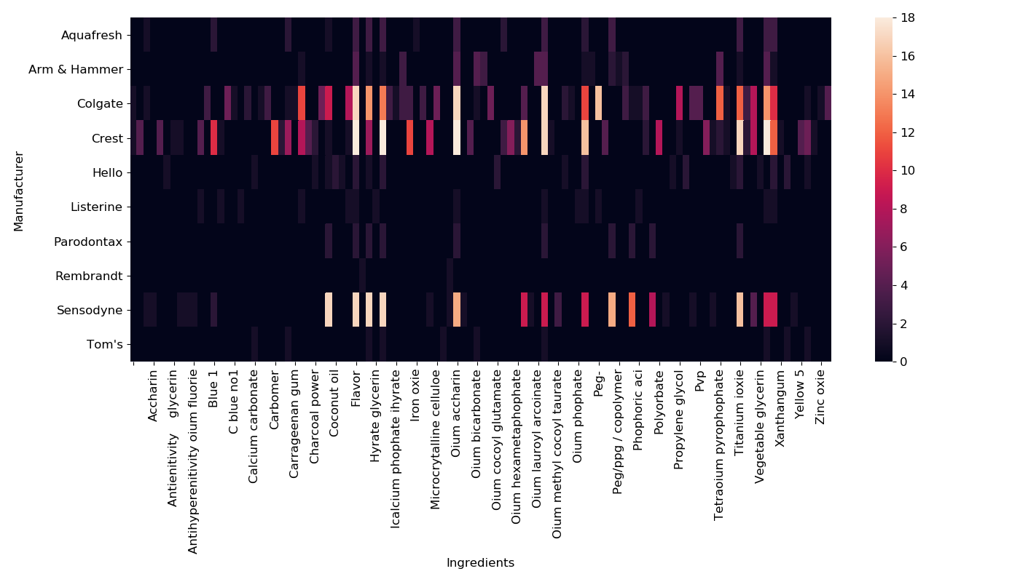
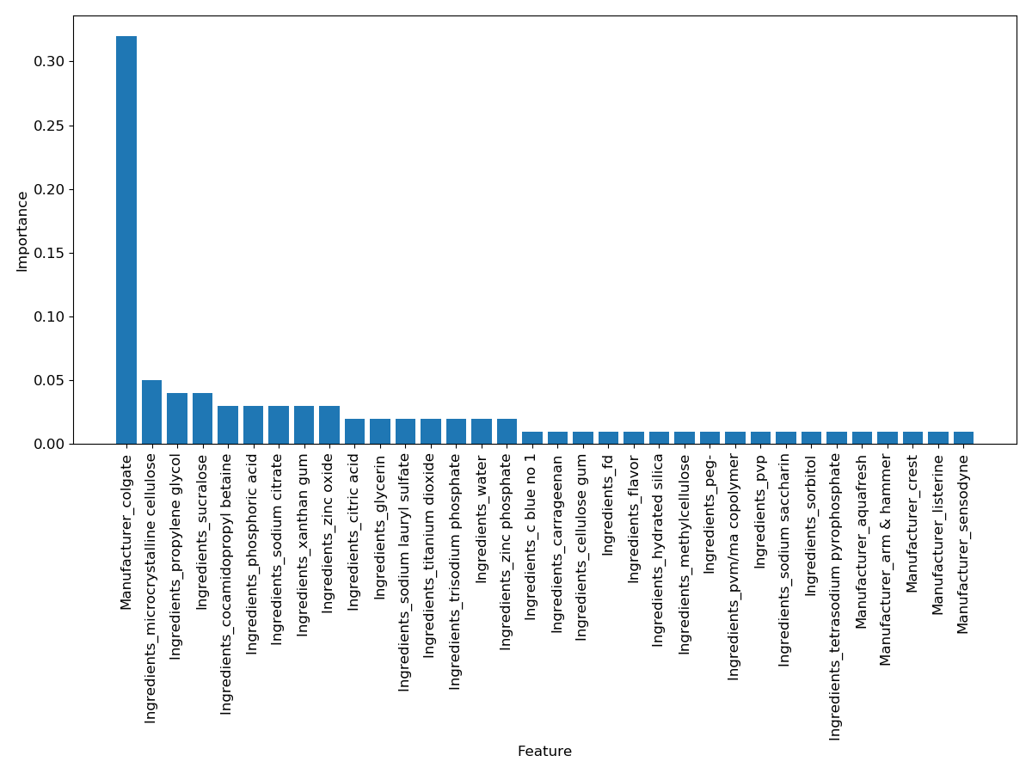
Importance of data (backup)

Slide 19
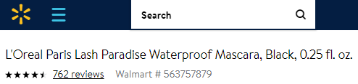
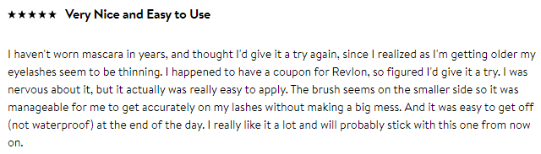
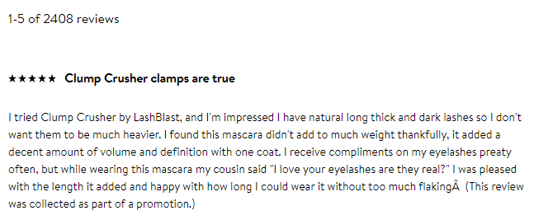
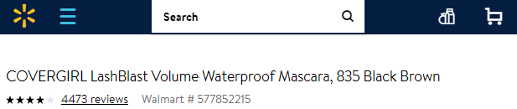
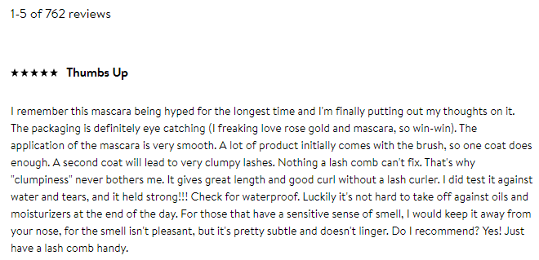
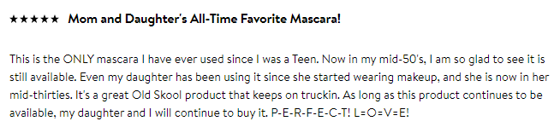
The nightmare that is Product Reviews (back up)

